Slide 1
Women Winemakers of California and Beyond
Lucia Albino Gilbert
John C. (Jack) Gilbert
SCU Oct. 29, 2024
Notes:
Thank you for joining us. 45 min for presentation, wine and discussion, and if time, view our website and mention 2 most recent studies.

Slide 2
Today’s Talk
Some context about the wine industry
We study lead women winemakers (WWMs)
The focus of our studies is illuminating lead WWMs presence and performance
Our book, Women Winemakers: Personal Odysseys
Our website; Most recent studies
Your questions and comments
Notes:
Visibility takes many forms: naming who they are and where they produce their wine;. Perf. takes form of recognition in the field, positions held, wine quality.

Slide 3
Cathy Corison,
Noted Napa Winemaker
“Back in 1978, when I did my first harvest, I never thought that women would be recognized as winemakers.”
Notes:
MS from UC Davis 1978

Slide 4
“Women of Wine” author, Ann Matasar (2006)
“No business or industry reaches further back in history or is more global in scope than the wine industry. And no industry has so resolutely excluded women from positions of influence for so long.”

Slide 5
Preparing for a Career in Winemaking
Strong science/engineering background, ideally followed by degree in E&V
Harvest experience in more than one country
Cellar experience*
Laboratory experience*
Confidence, persistence, focus, & strong work ethic
It is an applied science career path with several discrete steps.
Notes:
To provide context for talk. Lab position traditionally offered to women with science backgrd. Way to get foot in door but danger of getting stuck in lab. Cellar exp more difficutl for women to get access due to gender stereotypes

Slide 6
Notes:
2022 data 4807 wineries; in 2024 over 70% of the wineries prod less that 5000 cases (very small) or less than 1000 (limited prod, 50%) )More wineries in napa or Sonoma than in State of WA or state of OR

Slide 7
Our interest is the
Lead Winemaker
The person who has the primary responsibility for producing wine at a winery or winemaking facility.
Traditionally, very few women in this role

Slide 8
The Challenge of Finding CA’s Lead Women Winemakers
Responses from those we asked: “I am sure there are some. I just do not know who they are.”
Developed a database of all 3200 CA wineries and identified those with a lead WWM. It was 9.8 %.
Next, we developed an educational website to illuminate the WWMs we had identified.
Decided to study WWMs in major international wine regions.
Notes:
Lead WM: Person who has primary responsibility for the winemaking

Slide 9
Our website www.womenwinemakers.com
Educational, non-profit, searchable website to
Illuminate CA’s lead women winemakers and their career pathways,
Provide information to those interested in a career in winemaking, and
Share the results of our on-going research.
Archived at the UC Davis Library for its Viticulture and Enology Collection.
Notes:
UC Davis is the premier program in CA and one of those internationally in V&E

Slide 10
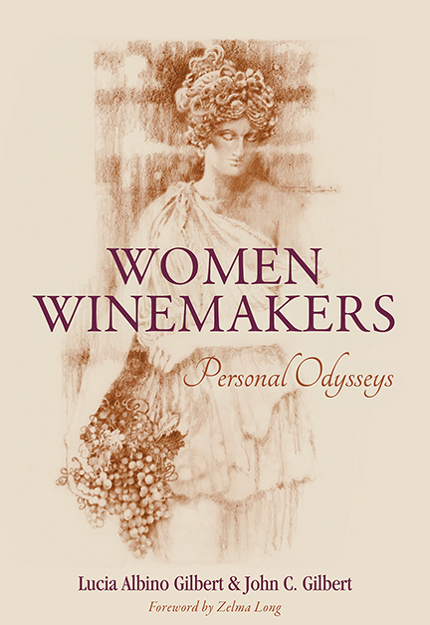

Slide 11
Odysseys
Odysseys are long, positive journeys.
Career paths are an example of Personal Odysseys.
Interviewed 150 women in CA & seven international wine regions about their career paths.

Slide 12
Book’s Organization
Part I: Focuses on trail-blazing women winemakers in CA & internationally
Part II: Describes women who entered the field after 1980, and followed one of the four career pathways we identified.
Part III: Reports on our studies re: WWMs presence and performance, and provides career advice from the WWMs interviewed.
Notes:
J of paris is 1976 which inc # of wineries and opportunity.

Slide 13
Eight Trailblazing CA Women: The Years 1965–1974
MaryAnn Graf (B.S.1965 UC Davis)
Zelma Long (B.S.1965 OR State; 1968 enrolled in UC Davis M.S. program)
Merry Edwards (M.S.1973 UC Davis)
Geneviève Janssens (1974 Nat’l Diploma of Enology, France)
Plus 4 others. All 8 studied science.
Winemaking was not an intentional career path as the field was not open to women at that time.
UC Davis premiere program in V&E in CA/globally.
Notes:
Zelma did harvest at Mondavi in 1970 and rapid rose to chief enologist but did not get stuck in the lab. Moved on to Simi as lead WM and then Vp at Chandon estates. In vintners hall of fame. Merry Edwards worked in the cellar(!), est own winery, also in vintners hall of fame. Janssens chief of wm at Mondavi

Slide 14
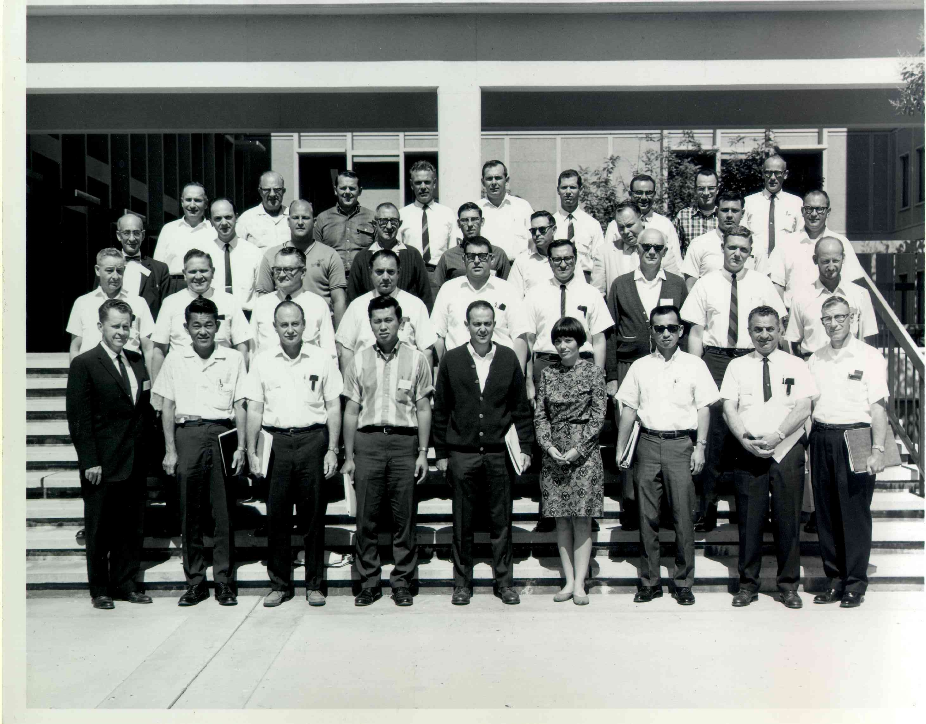
In 1965, MaryAnn Graf 1st woman to earn BS degree at UC Davis in Fermentation Sciences

Slide 15
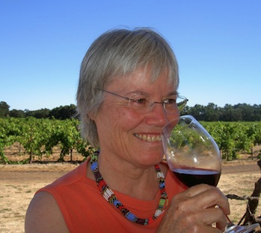
MaryAnn Graf
Ist lead woman winemaker: 1973
Independent and determined
Importance of a mentor
Notes:
first female winemaker in California since prohibition. 1965, first woman to graduate with a BS from UC Davis's premier program in Fermentation Science (now Viticulture and Enology). After her graduation, Graf gained experience working as a laboratory technician and assistant winemaker at several wineries. In 1973 she was hired as the winemaker at Simi in Sonoma following a four-hour-long interview with Andre Tchelistcheff, Simi’s consulting winemaker at the time. Graf was ably mentored by Tchelistcheff throughout her time there. Tchelistcheff is most notable for his contributions toward defining the style of CA best wines, such as CS. Called the "dean of American winemakers. "Hannah Weinberger is the first recognized woman winemaker in California. After her husband's death in 1882, she became the first female winery owner and winemaker in Napa Valley. She ran the Weinberger winery until Prohibition laws closed it

Slide 16
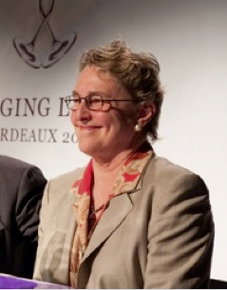
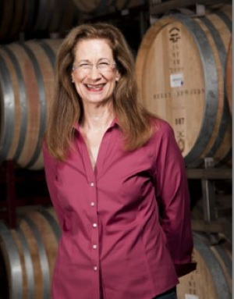
Zelma Long and Merry Edwards,
Major Figures in the Wine Industry
Notes:
Zelma Long (B.S. 1965; enrolled in UC Davis M.S. program 1970) Zelma did harvest at Mondavi in 1970 and rapid rose to chief enologist but did not get stuck in the lab. Moved on to Simi as lead WM and then Vp at Chandon estates. In vintners hall of fame. Merry Edwards, Queen of Pinot worked in the cellar(!), est own winery, also in vintners hall of fame. Janssens chief of wm at Mondavi

Slide 17
The Years1975—1979 and the Judgment of Paris (1976)
Increase in # of wineries and positions. More opportunity for qualified women who later become lead winemakers. Examples include:
Eileen Crane
Cathy Corison
Carol Shelton
Notes:
We identified a total of 15. Crane founding winemaker and CEO at Domaine Carneros. Judgment of paris blind tasting of chardonnay and of CS from CA and fr Bordeaux.

Slide 18
Part II: The Career Pathways
Sensory
Family
Science/Agronomy
Enology
Note: Jack will provide snippets from selected odysseys.
Notes:
Read from study’s protocol

Slide 19
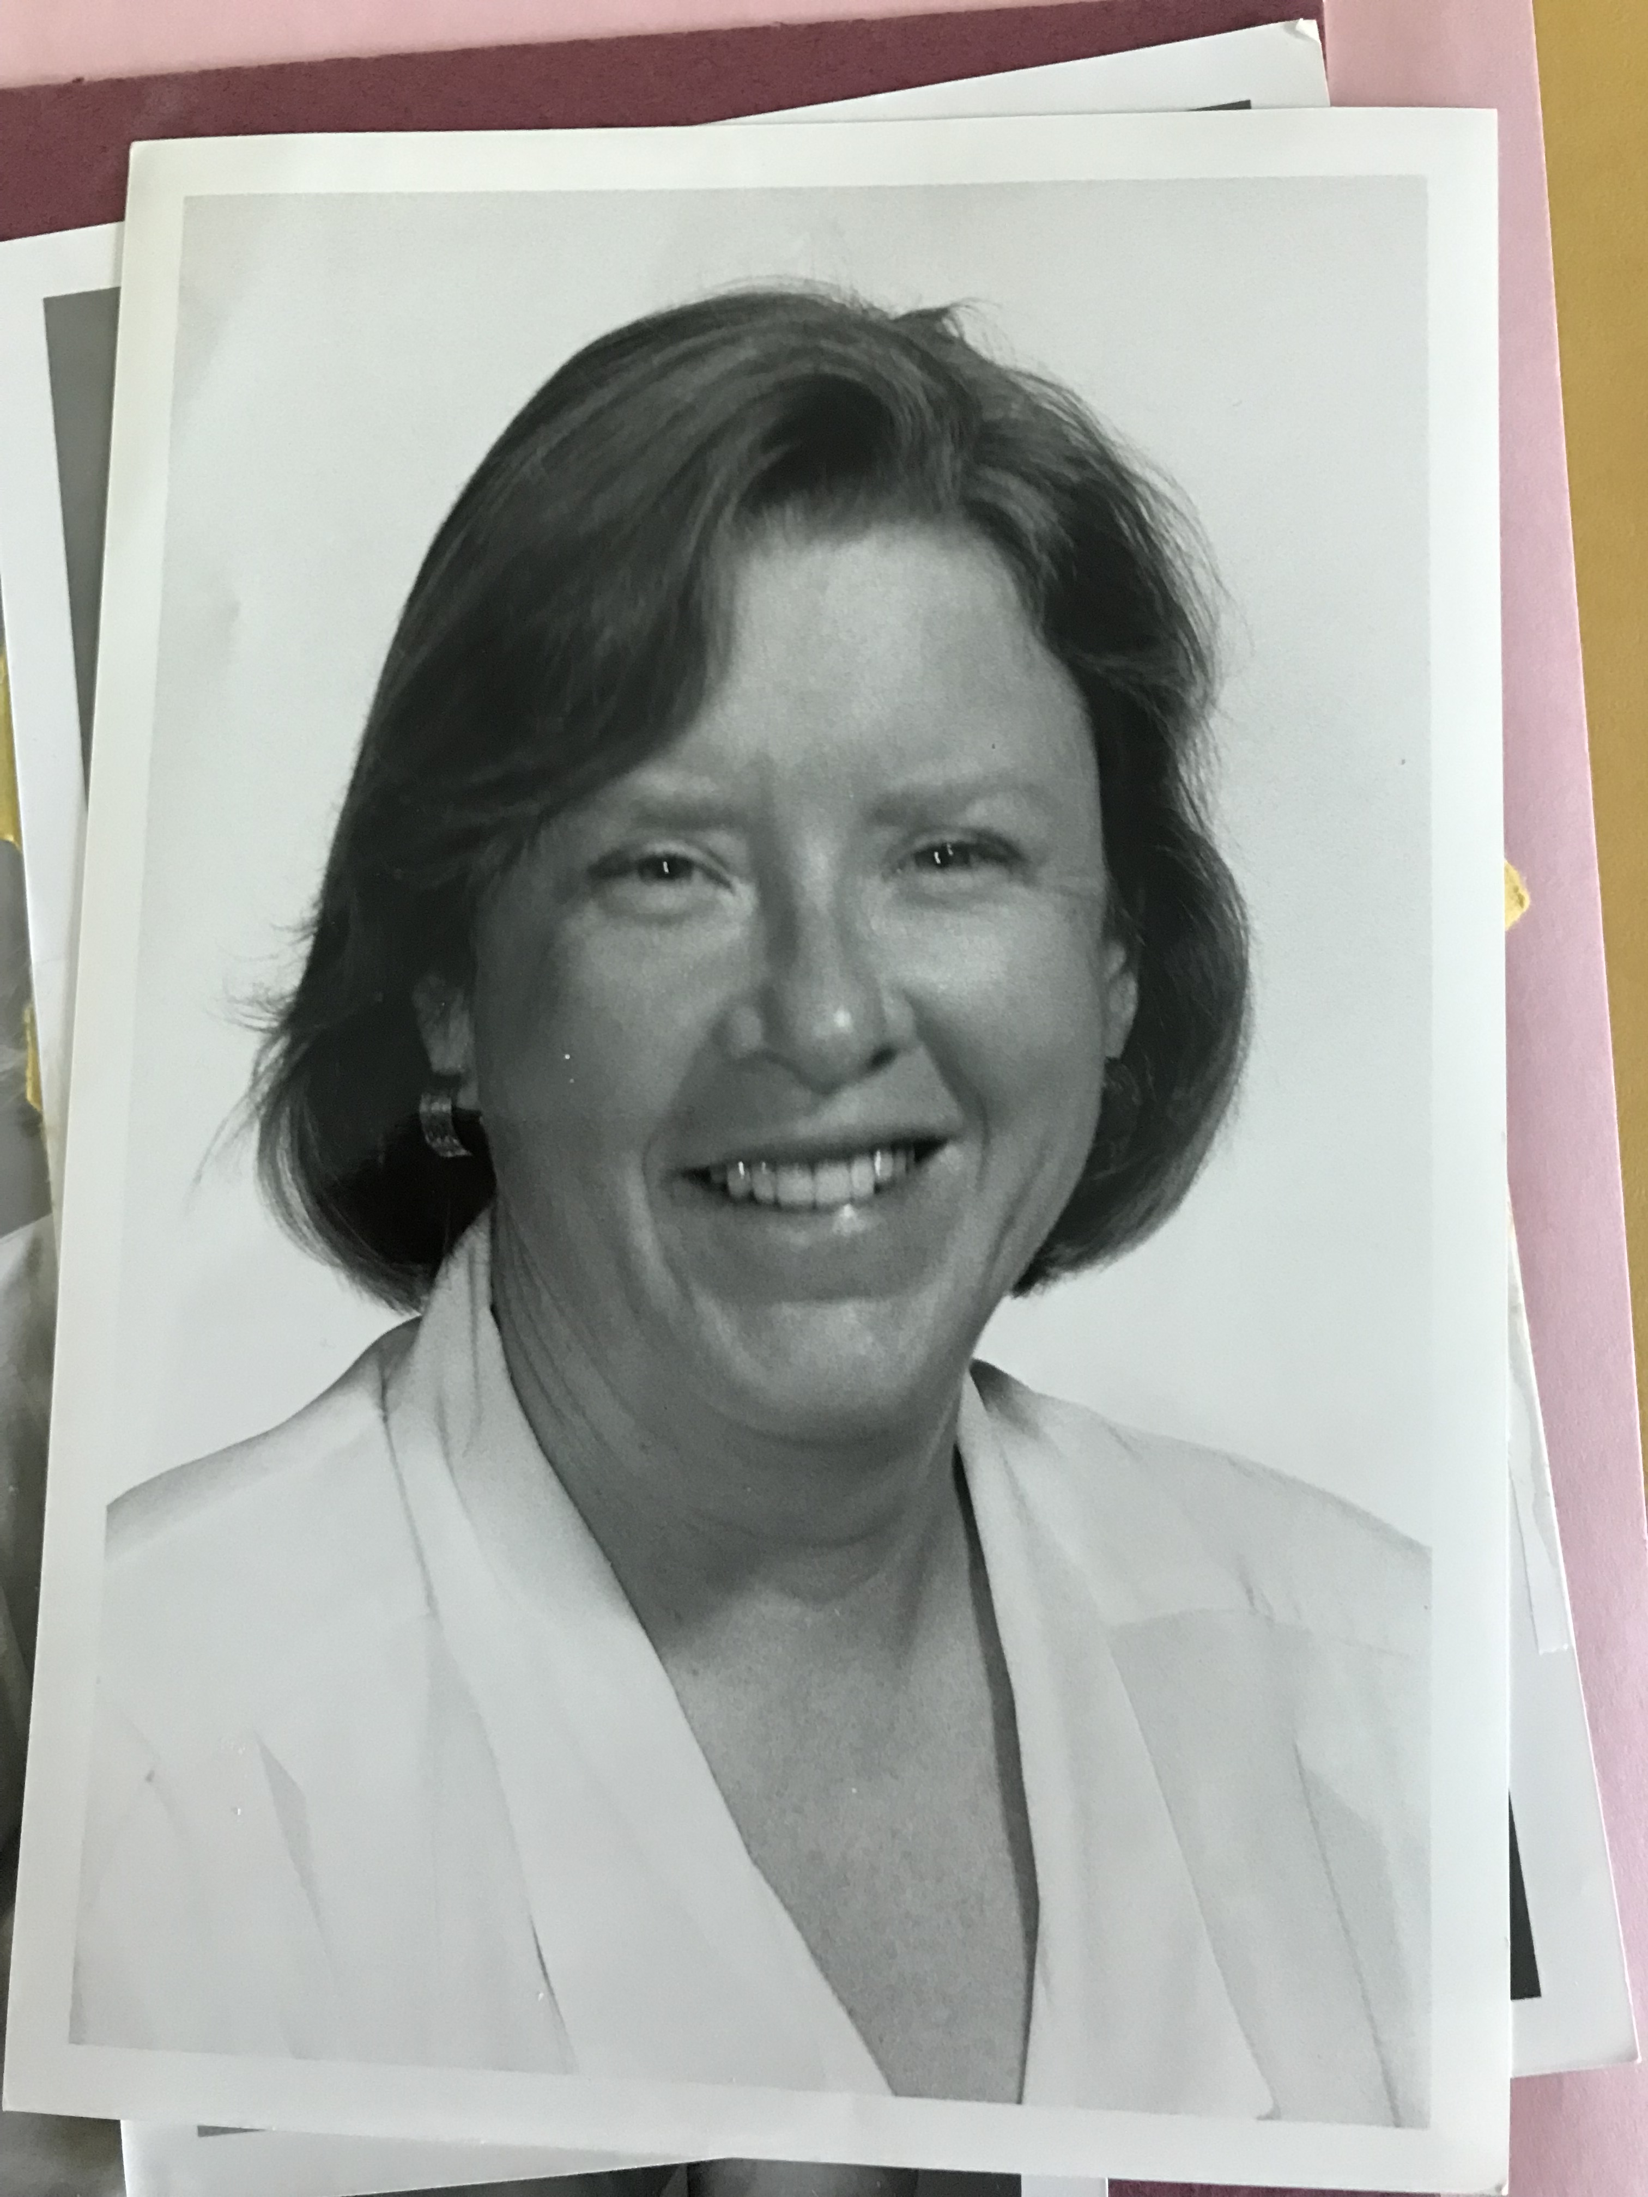
Ann C. Noble, Professor of Sensory Science, UC Davis
Creator of the Aroma Wheel
Acclaimed teacher & mentor.
In 1974, 1st woman hired at UC Davis in E&V.
Notes:
UC Davis is the premier program in V&E

Slide 20
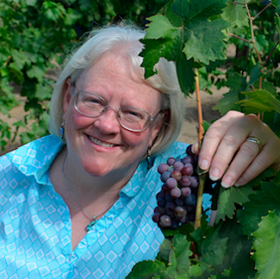
Carol Shelton and the Sensory Pathway
  “Queen of Zin”
  Know when it’s time to leave a position
Notes:
A common pathway regardless of wine region

Slide 21
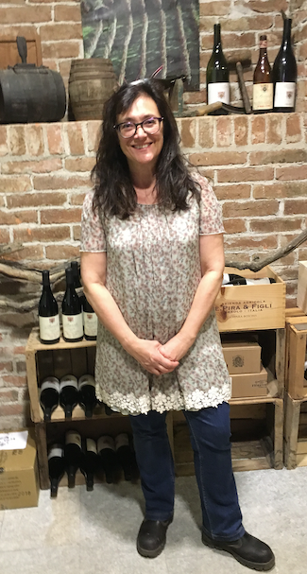
Chiara Boschis and the Family Pathway
1st woman winemaker in Barola (1990)
Sole woman member of the “Barola Boys”
Notes:
Very few family pathways in CA Prevalent in Italy, spain, and france

Slide 22
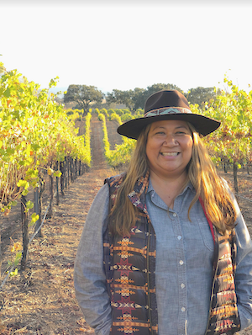
Tara Gomez and the Science/Agronomy Pathway
CA’s 1st Native American lead WWM.
Winegrowing supports individual & tribal identities as stewards of the land.

Slide 23
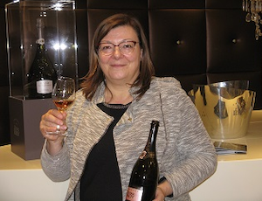
Sandrine Logette-Jardin and the Enology Pathway
1st woman chef de cave in Champagne region (2005)
Knew she had to have “a strategy”
Notes:
Now 6 women chef de caves

Slide 24
Commonalities and Lessons Learned
Career paths were often not linear.
Mentors, role models, a supportive partner, and collegial network are of central importance.
Thick skin, passion, perseverance, and focus are essential.

Slide 25
Evidence for Women’s Winemaking Performance from Our Research
Empirical study showing that CA wineries having lead women winemakers are more highly acclaimed, proportional to their representation in the field (see Ch 8).
Annual “tracking” of top 100 wines in Wine Spectator (WS) and Wine Enthusiast (WE).
Notes:
In Odyssey we shared, WWM performance speaks for itself. Want to take a minute to look at our efforts in this area. Following same idea of prop representation do annual tracking

Slide 26
Annual “Tracking” Example
In 2023, 22 CA wines were included in WE Top 100 Wines, and of those, 7 (31.8%) were from wineries having a lead woman winemaker.
Note: 31.8% is greater than woman winemakers’ 14% representation in the field.
For the past four years, 20 to 30% of the wineries included in "Top Lists" have lead women winemakers.

Slide 27
WWMs on Wine Enthusiasts’ 2023 List of Top 100 Wines
#1 René Ary, WM, Duckhorn 2019 Cabernet Sauvignon
#9 Heidi von der Mehden, WM, Merry Edwards 2021 Pinot Noir (SCU grad in chemistry, 1997)
#34 Carol Shelton, WM, Carol Shelton Wines, 2020 Albini Zinfandel
Notes:
. Rene rose through the ranks from lab manager to enology manager, assistant winemaker and associate winemaker, and then in 2014 named the fourth winemaker in the four-decade history of Duckhorn Vineyards. Now VP for WM

Slide 28
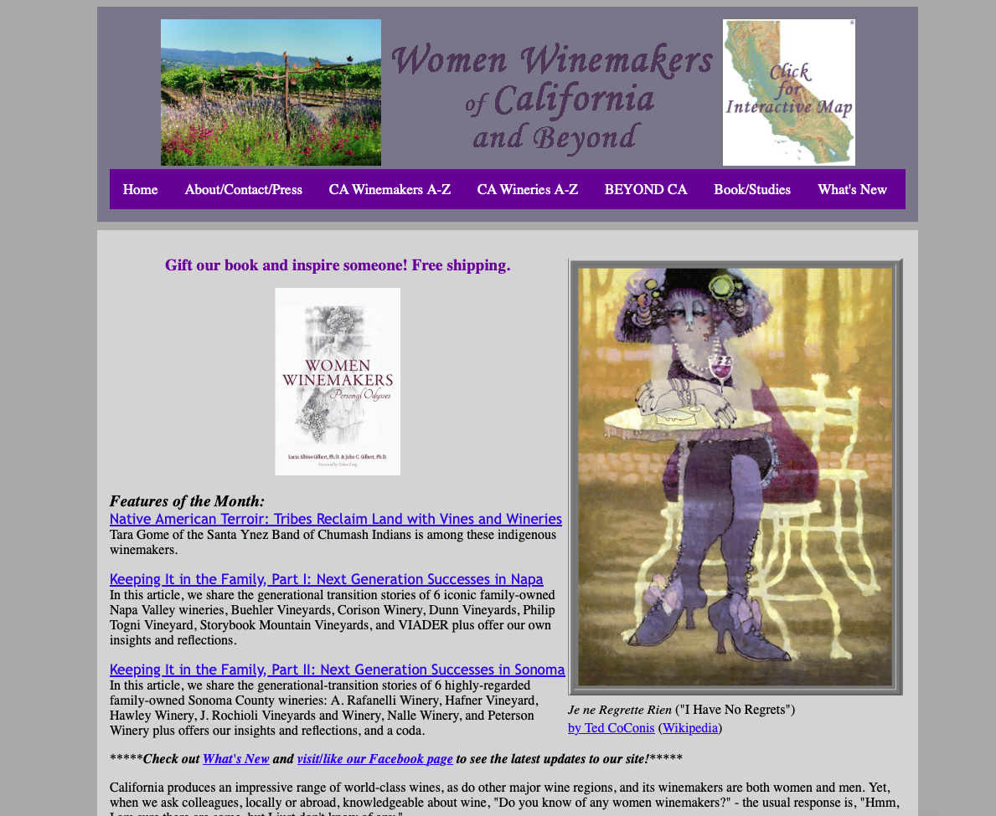
Homepage of Website

Slide 29
Discussion
Questions
Suggestions
Comments

Slide 30
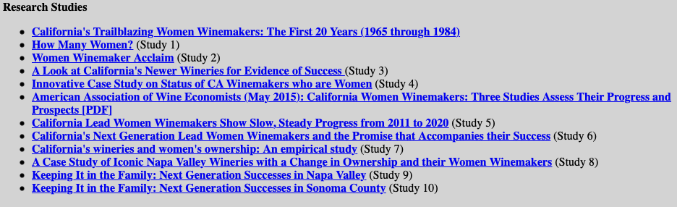
Our Studies to Date
Notes:
Ive

Slide 31
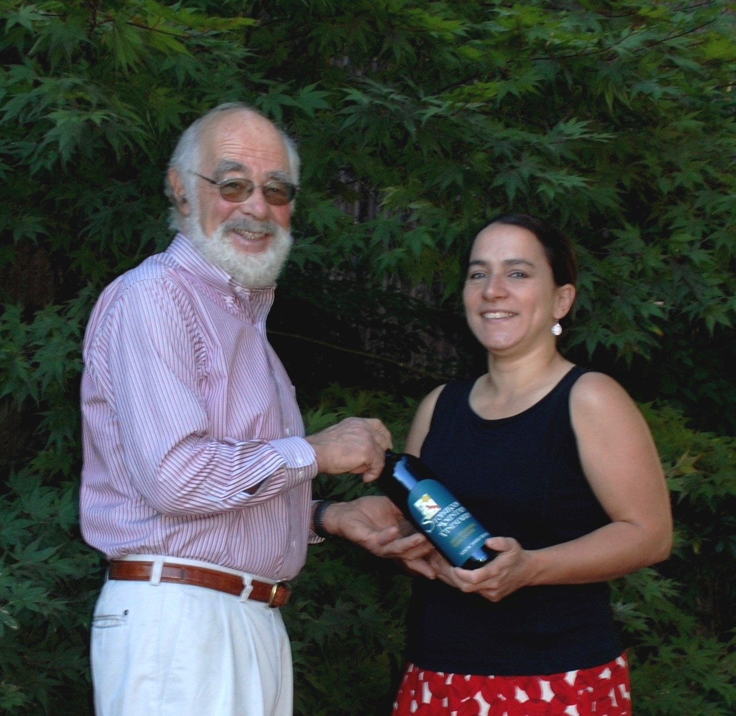
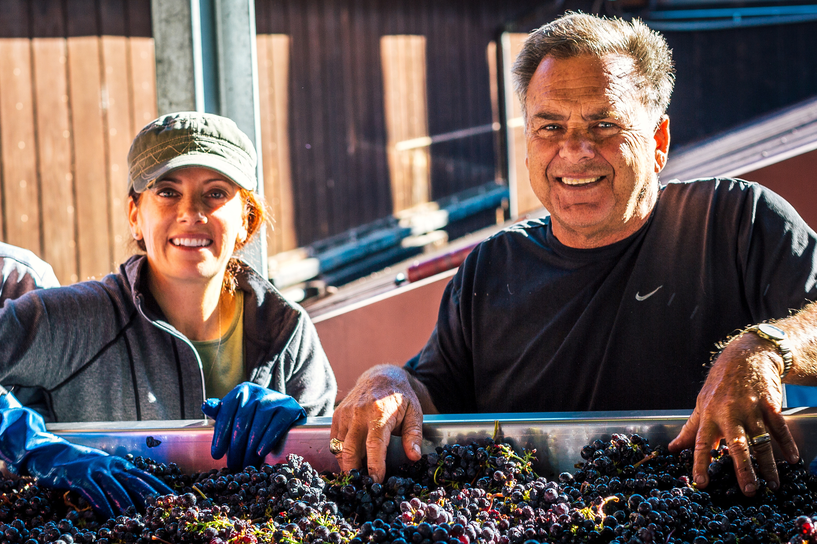
Our 2024 Studies,“Keeping It in the Family— Next Generation Successes in Napa Valley and in Sonoma County.”
Several from father to daughter
Notes:
Storybook winery jerry seps napa raf winery Sonoma shelly and dave

