Slide 1


Dollars and Sense
What Stories are Your Donor Funds Telling?

Slide 2

Introductions
Laura Gatewood, Assistant Vice President, Donor Relations
Kelsey Parker, Assistant Director, Scholarship and Endowed Funds

Slide 3
Dollars and Sense
Unspent donor funds in higher education – scope and implications
Identifying and tackling the known and unknown issues
Building strong campus-wide partnerships
Tools + Roadmap = Real Results

Slide 4
2024 Donor Relations Group Survey
52% of higher ed institutions reported that unspent donor funds accounted for more than half of their most recent fundraising totals.
  30% of all respondents held $1m – $9.99m
  17% had $10m – $100m
  5% reported over $100m sitting idle
Only 4% felt “very comfortable” with their current unspent fund levels, while more than 80% expressed some level of discomfort.
Does this sound familiar?

Slide 5
The Gift Cycle
University Advancement engages and solicits donor
University Advancement
reports impact to donor
Donor makes a gift with restricted purpose
Department spends gift in alignment with established criteria

Slide 6
Focus on Programmatic Funds
Little to No Spending or Misreporting
Deeper Review of all Programmatic Funds
Frequent Communications with Fund Administrators

Slide 7
Cash Accumulation

Slide 8

Tackling the Problem

Slide 9
Relationship Building
Focus on Programmatic Endowed Funds First (Low-Hanging Fruit)
Gained traction slowly – we weren't popular at first
  Develop new ways of engaging - connect with the right people
  Mitigating effects of turnover
    Multiple touchpoints throughout the year
Mindsets changed
  “Money Police” → Valued Partners
  Bring solutions to meetings – show your value!

Slide 10
Leveraging Partnerships
Donor Relations made this a top priority
Major win: Partnership with the CFO and Controller's Office
Know your audience(s): Secure a liaison
High-level advocacy: You need a champion (Provost)

Slide 11
Nuts and Bolts

Slide 12
Qualitative and Quantitative Evaluation
Fund Criteria Scale
  Rates the restriction level of a fund's criteria on a scale of 1-4 (1 being least restrictive)
Balance to Distribution Ratio
  Measures accumulated spendable balance against the current FY's distributions

Slide 13
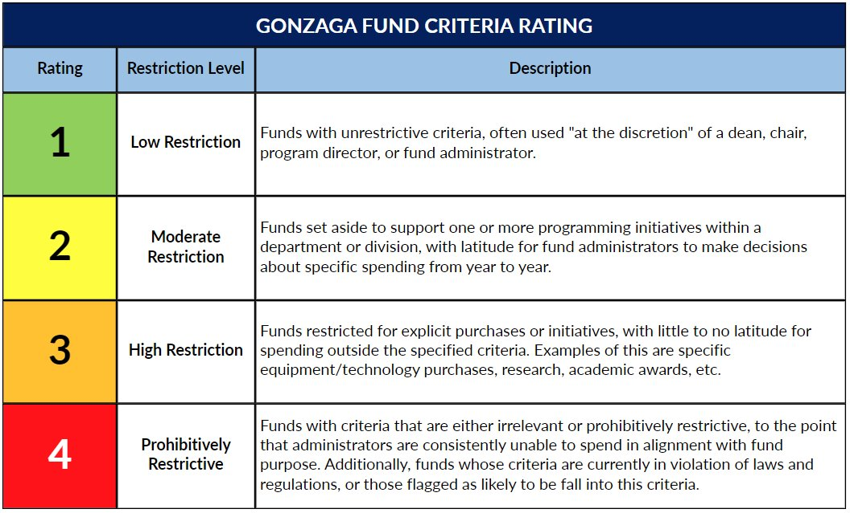

Slide 14
Fund Criteria Example
Spike Bulldog Family Jazz Program Endowment
Purpose/Criteria: To be used in support the Jazz Program at the discretion of the Jazz Program Director.
Potential uses:
  Purchase music
  Equipment purchases and repairs
  Travel costs for performances and recruiting
  Hosting guest artists and performers

Slide 15
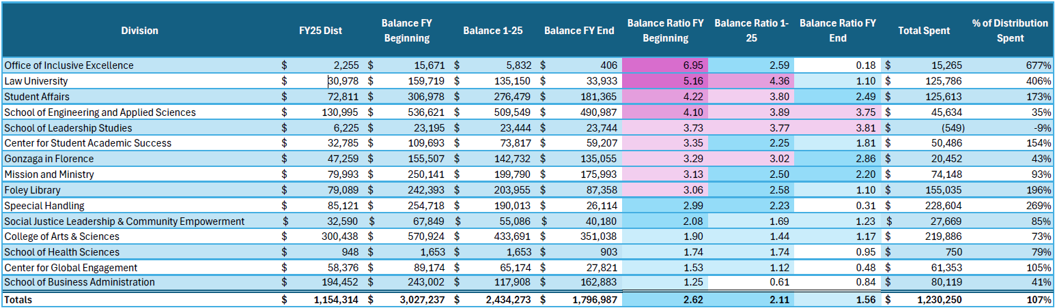
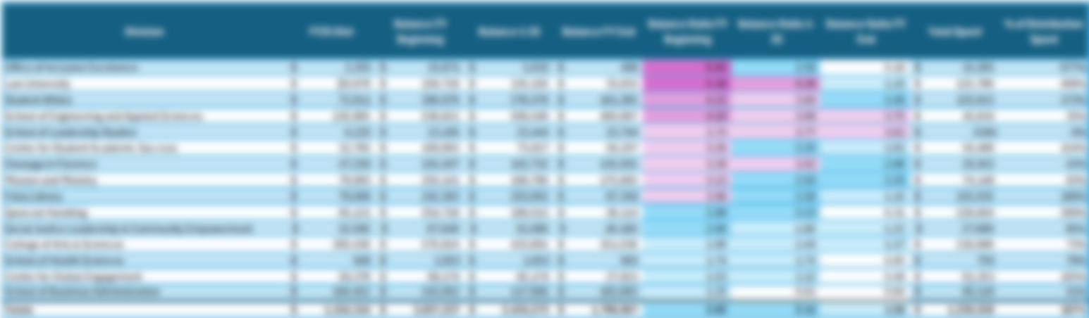
Balance to Distribution Ratio (“The Heat Map”)

Slide 16
What’s at Stake?
Keep a close eye on “idle cash” balances because they impact the university in multiple ways:
  Fundraising Challenges → Gift Cycle
    Donor relationships
  Pressure on general operating budget → Tuition increase
  Insulated from operating budget cuts

Slide 17
Fund Review Spreadsheet
Tracks all donor-supported programmatic and chairs funds.
  Title, all relevant codes, and divisional oversight
  Criteria and scale rating
  Financials (conditional formatting creates the "Heat Map")
    Current FY Distribution
    Spendable Balance
    Balance to Distribution Ratio

Slide 18
Impact at Gonzaga

Slide 19
Balance Ratio Trend

Slide 20

Toolkit

Slide 21
Charting your course
Fund Review Spreadsheet
  Criteria Scale
  Heat Map
Meeting Cadence
  Attendees: Deans/Directors, Budget Admins, Donor Relations Staff, Faculty Liaison, Gift Officers
  Frequency: 2-3 times/year. Fall, Mid-year, Fiscal year end
Campus Partnerships
  Provost, Finance workshops

Slide 22
Key Takeaways
Know your data!
  Funds you are tracking and associated criteria
  Financials: distributions, cash balances, ratios
Develop strategic partnerships
  Deans/Directors, Budget Admins, Provost, Finance, Faculty liaison
  Meeting cadence, schedule early in the year
  Get comfortable with being uncomfortable
Be a year-round resource
  Know and show your value
  Respond quickly and clearly

Slide 23
Real Results
FY23: 58% of endowed funds held >3 years of distributions
FY26: Reduced to 23%
Since Provost engagement, endowed fund utilization has more than doubled
Pace your progress - small steps lead to lasting change.

Slide 24

Questions?

