Slide 1
Amplifying Alumni Engagement: Evergreen Events & Campus Partnering
Lynn Langnas & Connor Quealy
JAA Conference 2025
July 21, 2025

Slide 2
Session Overview
Challenges of boosting alumni engagement with limited budget and staff resources
Learn practical strategies for leveraging campus partnerships
Low-lift, repeatable, digital events/programming at minimal cost, minimal staff time
Walk away with real-life examples & action items

Slide 3
The Challenges
Flat or shrinking budgets, staff bandwidth & resources
Event fatigue among alumni
Geographic spread of alumni
What does engagement look like for SJU

Slide 4
Engagement that Works Everywhere and for Everyone
Evergreen Events:
Evergreen events are creative, sustainable programs that keep alumni connected without relying on large budgets or in-person gatherings.
These initiatives offer thoughtful, year-round engagement opportunities that reflect alumni interests, values, and professional goals.
One Campus, One Team:
By collaborating strategically with campus partners, we can engage with more alumni and attract new alumni to be engaged with the university.
These collaboration efforts also help keep messaging and programing unified across the university.

Slide 5
Sample Evergreen Events
Community & Learning: Alumni Learning Consortium, Virtual Tours, Digital Yearbooks
Professional: Monthly Headshots, Career Habits webinars; Advice to graduating seniors
Jesuit Identity: Lenten & Advent Reflections, Month of Gratitude, Letters to Elders

Slide 6

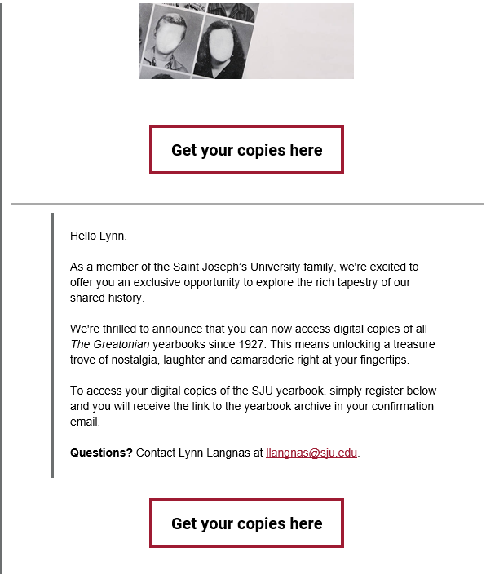

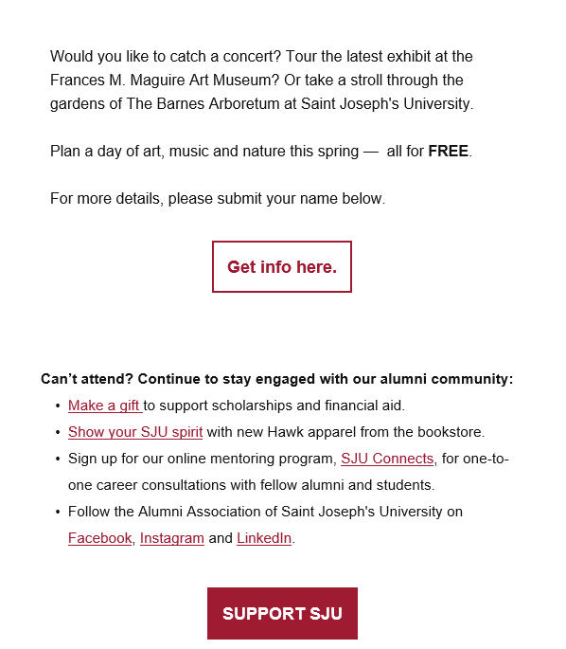
Marketing

Slide 7
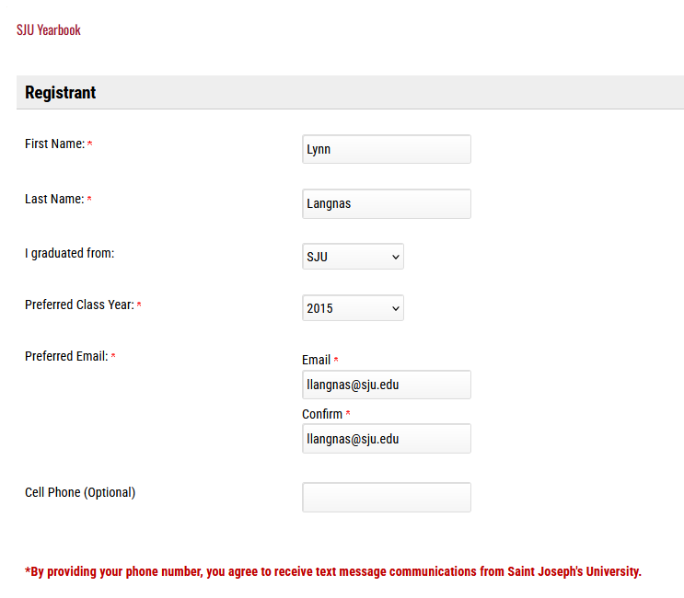
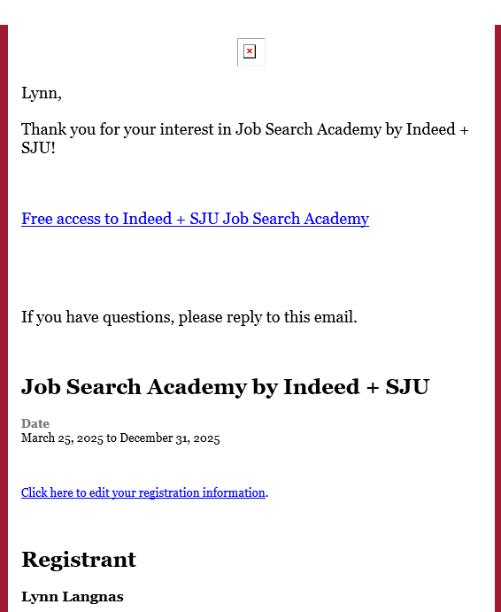
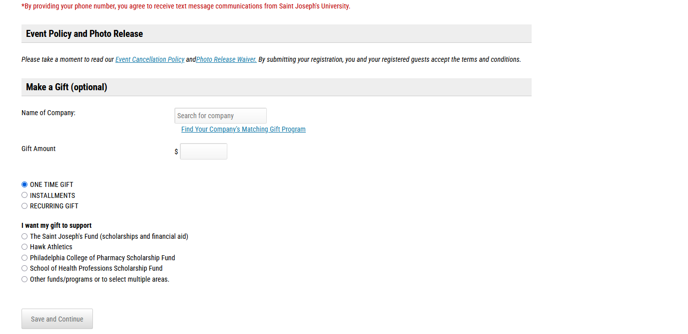
Registration Confirmation email

Slide 8

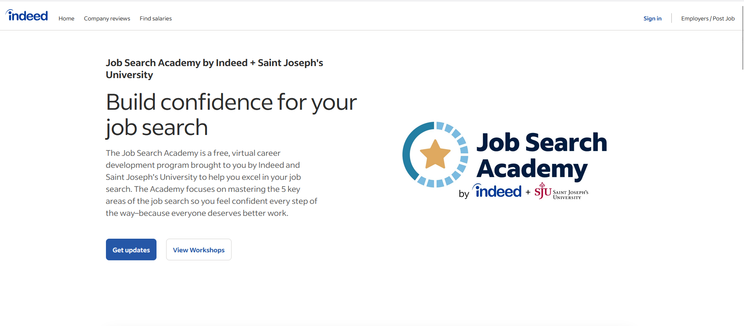
Product

Slide 9
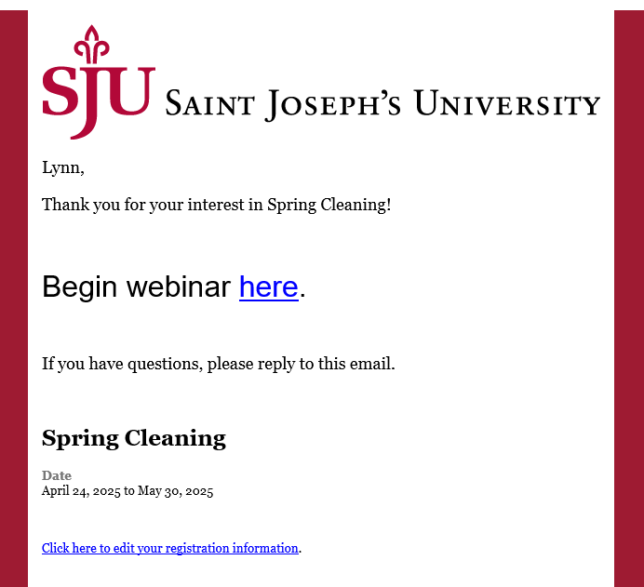
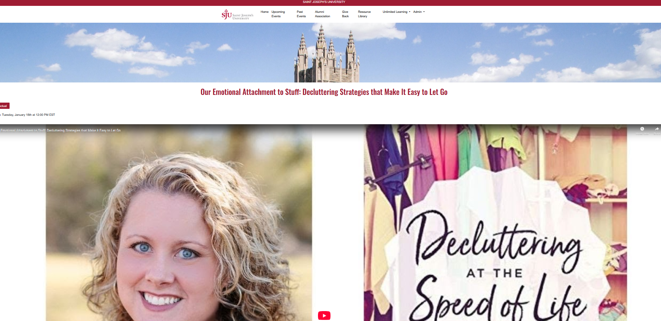

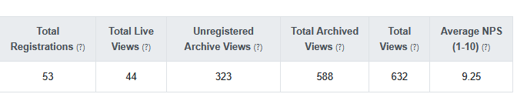
Product
Total archive views
# of registered & unregistered view
unregistered archive views
# of people who did not registered but watched

Slide 10

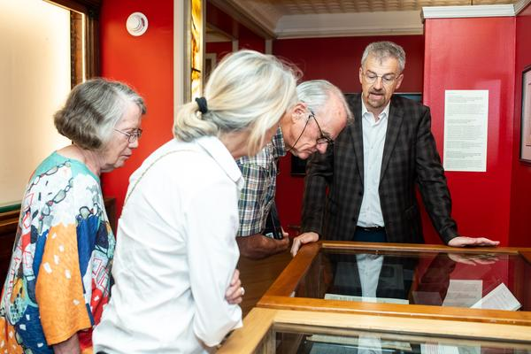
One Campus, One Team

Slide 11
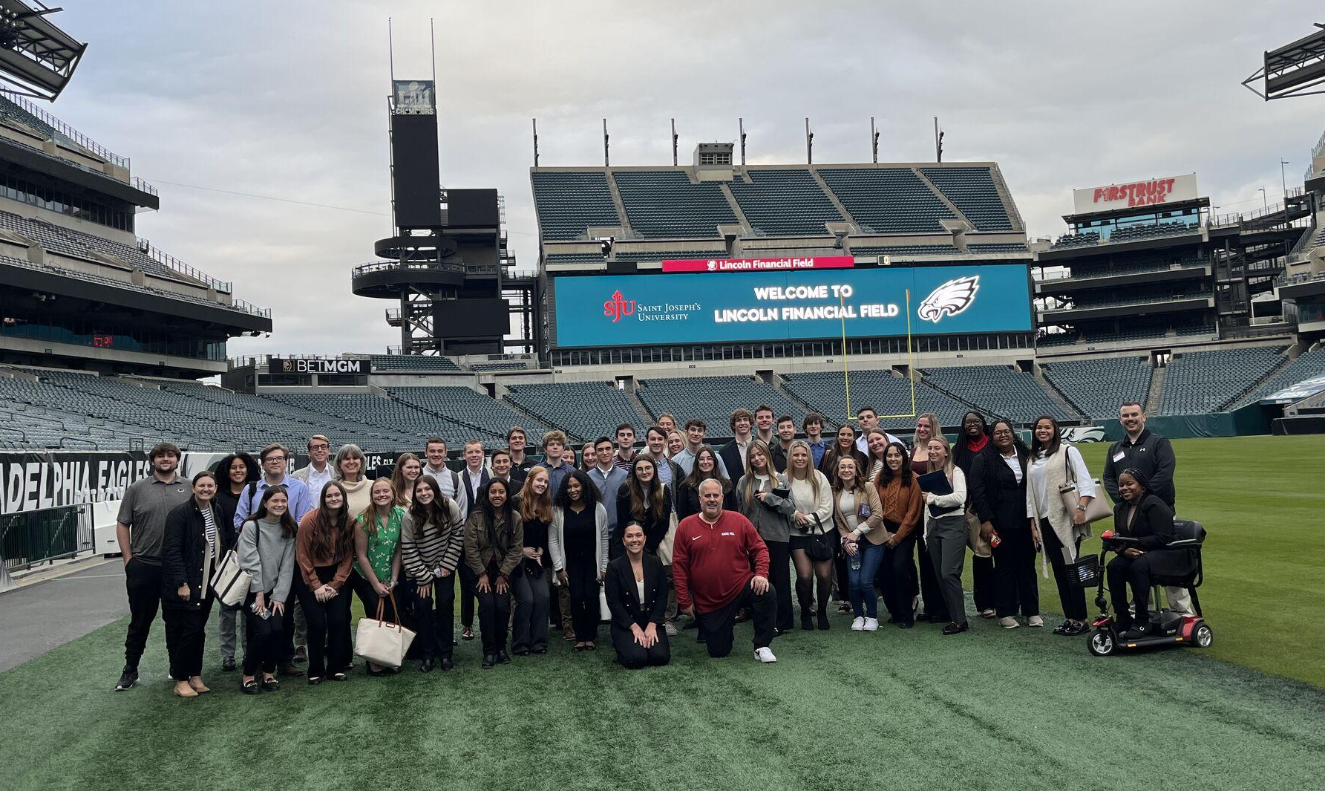
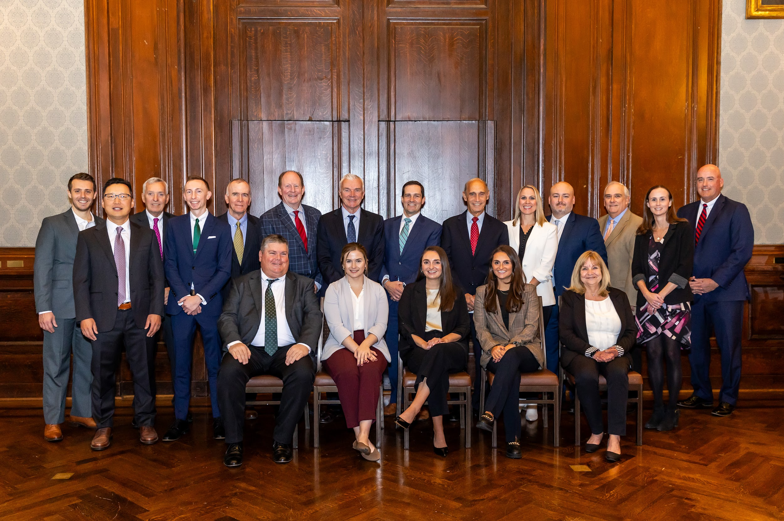
Areas of Support
Alumni Contact Information
Admission Support
Budget Alleviating Programs
Career Development
Event(s)

Slide 12
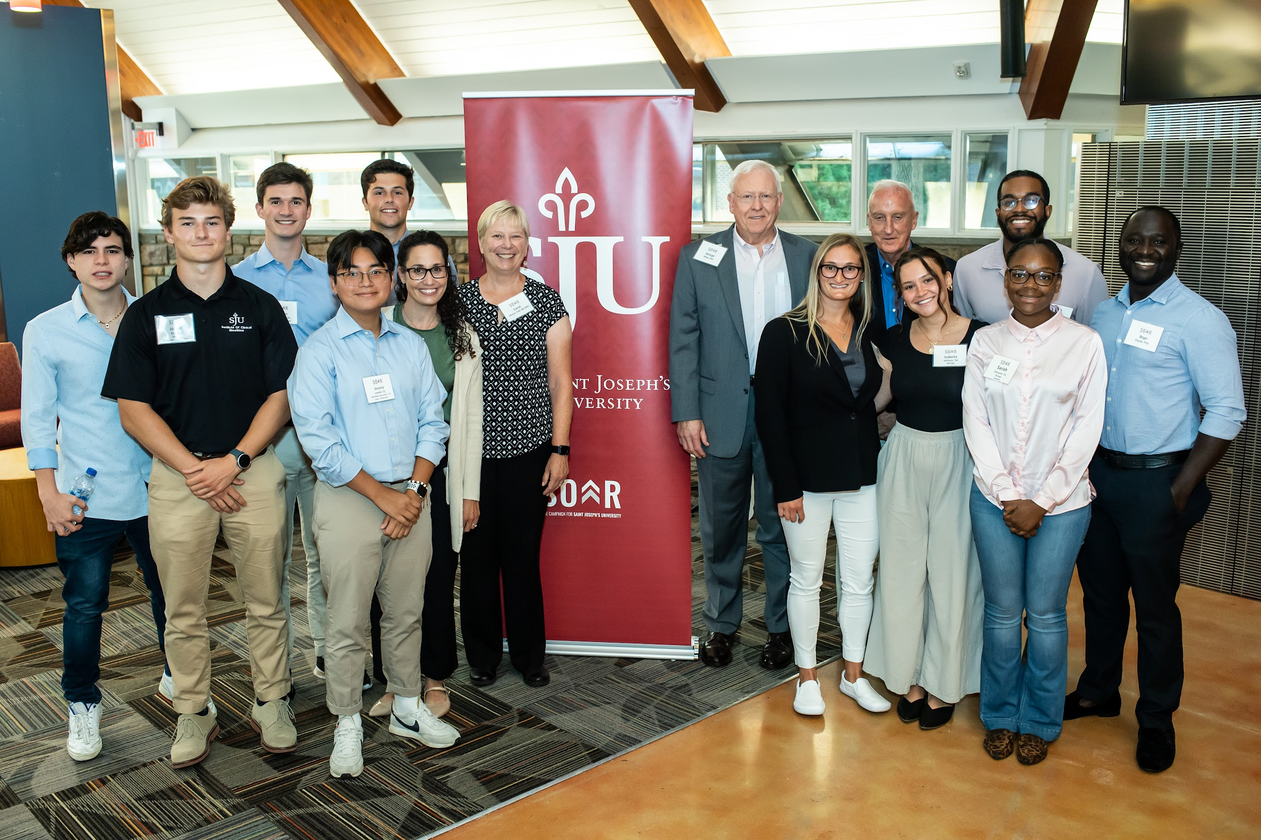
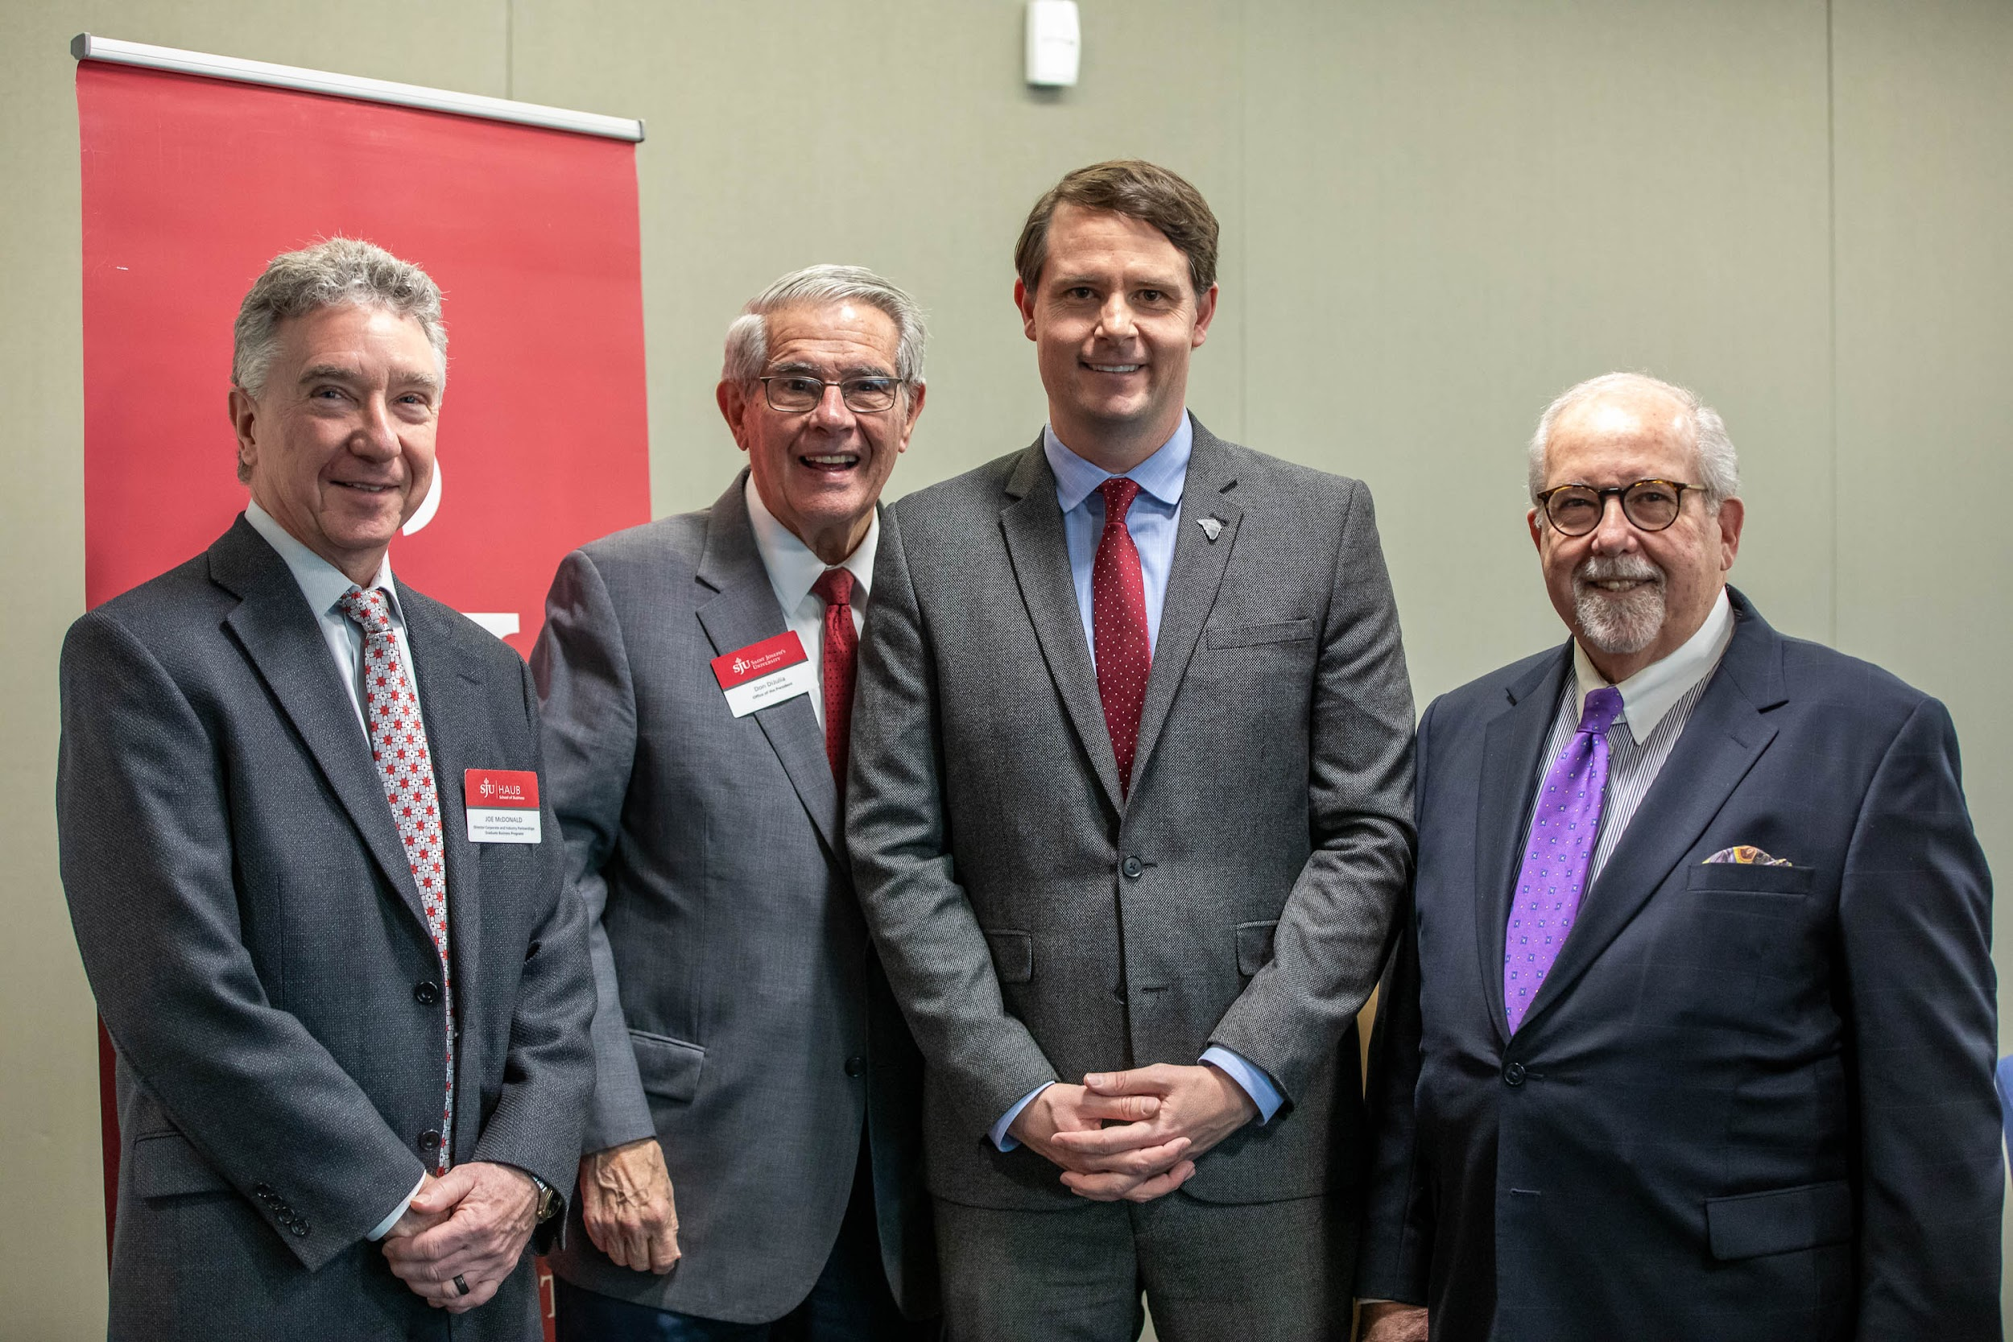
Areas of Support
Fundraising
Thank you gifts / SJU
Mentoring
Resources
Volunteers

Slide 13
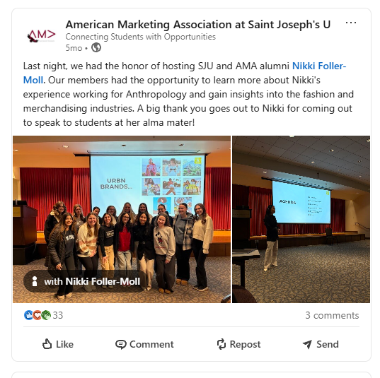
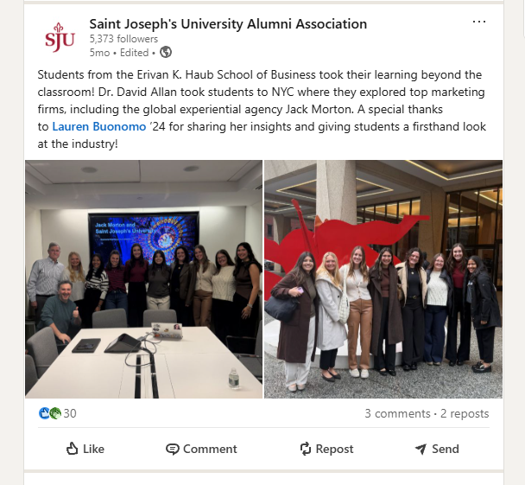
“Now is the time to collaborate and listen!”

Slide 14
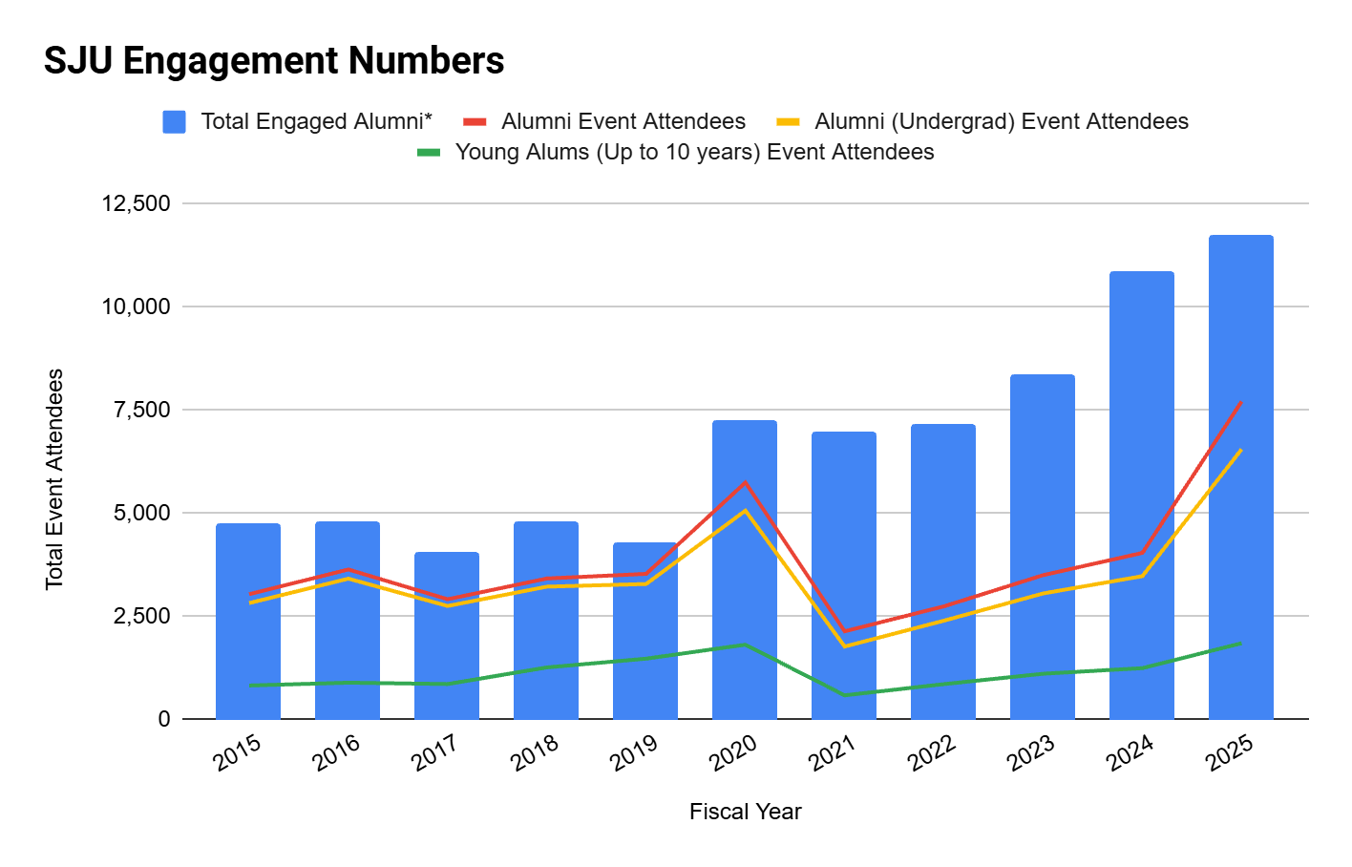
Engagement Data

Slide 15
Fiscal Year | Total Events | In-Person | Virtual | Evergreen Events | Total Engaged Alumni* | Alumni Event Attendees | Alumni (Undergrad) Event Attendees | Young Alums (Up to 10 years) Event Attendees | Undergraduate Donors | Students Event Attendees**
2021 | 127 | 6 | 121 | x | 6,985 | 2,139 | 1,770 | 586 | 4,477 | 1
2022 | 158 | 67 | 91 | x | 7,151 | 2,745 | 2,397 | 858 | 3,918 | 15
2023 | 181 | 133 | 48 | x | 8,378 | 3,502 | 3,058 | 1,110 | 3,365 | 94
2024 | 214 | 168 | 46 | 10 | 10,871 | 4,042 | 3,478 | 1,246 | 3,169 | 192
2025 | 224 | 168 | 56 | 35 | 11,760 | 7,716 | 6,556 | 1,851 | 2,942 | 747
*This number represents each unique person/ID that was engaged with SJU; event attendee, donor, volunteer, other.*

Slide 16
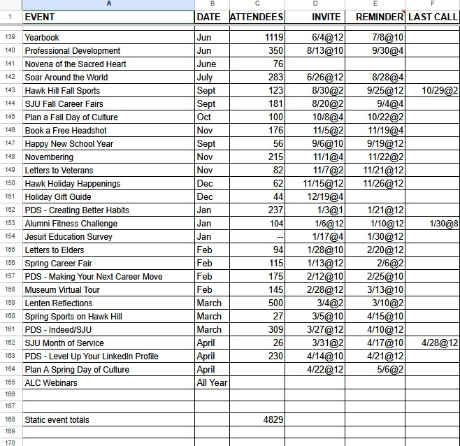
Evergreen Events for 2024-2025
37% first time
30% first time
20% first time

Slide 17
Return on investment
$10,000+ in New Donations
Fundraising
Participation from wide range of alumni
Reusable structure across audiences

Slide 18
One Campus, One Team - A Two Way Street
Campus Partners Alumni Engagement / General Alumni Engagement Recording
  FY24 - 121 & FY25 - 194: Names Provided
Athletics: 2,981 in FY25
Lenten Reflections: 493
FMM - Museum Visitors:458

Slide 19
Call to Action: Make It Work on Your Campus
Start small: pick 2 events to try
Partner with other departments
Use newsletters to amplify - alumni advantages
Repurpose existing content
Measure, refine, repeat
Start with two campus partners and grow
Notes:
You don’t have to overhaul your calendar. Start with one or two events, see what sticks, and build from there. Tap into your career center, mission office, or library. Use what you have — and most importantly, track results so you can tell the story of your success.

Slide 20
Lynn Langnas
Director alumni programs
llangnas@sju.edu
Connor Quealy
Assoc Director alumni engagement
cquealy@sju.edu

