Slide 1
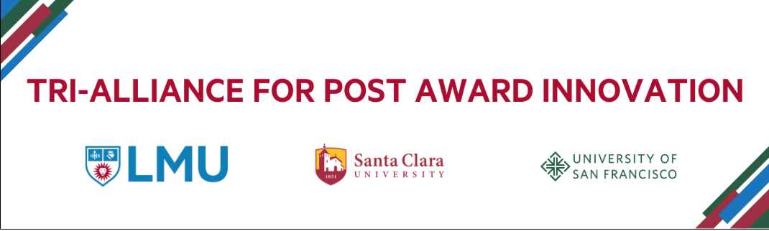
The Power of Partnerships:
What CFR Can Learn from Existing
AJCU Multi-University Resource-Sharing Collaborations
July 22, 2025
This material is based upon work supported by the National Science Foundation under Award Nos. 2415723, 2415724, and 2415725. Any opinions, findings and conclusions or recommendations expressed in this material are those of the author(s) and do not necessarily reflect the views of the National Science Foundation.

Slide 2



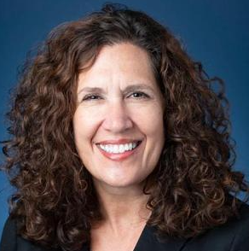
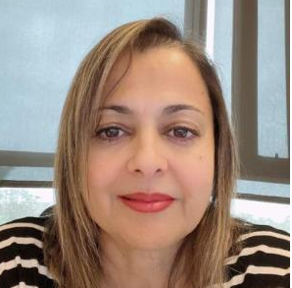

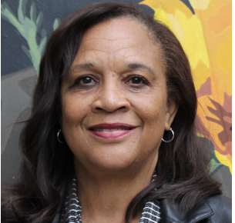
Tri-Alliance Team
Angie Rochat
Principal Investigator (PI)
Assistant Vice Provost for Research
Loyola Marymount University
Angie.Rochat@lmu.edu
Aida Shadfan
Co-Principal Investigator (CO PI)
Vice President for Finance and Controller
Loyola Marymount University
Aida.Shadfan@lmu.edu
Mary-Ellen Fortini
Principal Investigator (PI)
Senior Director of Sponsored Projects
Santa Clara University
mfortini@scu.edu
Camille Coley
Principal Investigator (PI)
Associate Vice Provost & External Partnerships
University of San Francisco
ccoley@usfca.edu

Slide 3
Who is Good Partner?
Long-Term Collaboration
Seek partners with whom you can build a lasting working relationship.
Aligned Purpose
Choose partners who share similar goals and values.
Open and Honest Communication
Share successes, challenges, and setbacks to foster trust.
Transparency
Maintain honesty and clarity in all interactions.
Frequent Communication
Engage in regular discussions to ensure alignment and collaboration.

Slide 4

Year One:
Strengthen Post-Award capacity
Develop shared training and tools
Pilot innovative administrative roles

Slide 5
Why This Matters for CFR
Demonstrates a strategic and scalable model for administrative innovation
Sustainability of research infrastructure
Impactful cross-institutional collaboration
Aligns with core foundation and corporate values: Innovation, Education, Impact
Collaborating rather than competing with the small pool of Catholic/Religious Funders
Notes:
So why should CFR leaders care about post-award infrastructure?
Because your funders care about it. When funders assess whether to invest in an institution, they look beyond mission alignment—they look at capacity. Can we administer complex grants? Can we report impact clearly and efficiently?
This work:
Demonstrates a scalable innovation model
Addresses funder concerns about overhead, accountability, and results
Shows how cross-institutional collaboration can amplify impact without multiplying costs
We believe this collaboration model can help CFR offices build confidence with funders—and even open the door to joint proposals and shared initiatives.

Slide 6
Alignment with Funder Priorities
1. Education:
Empowers early-career researchers and staff with joint training and toolkits
Promotes research-readiness at teaching-focused institutions
2. Research:
Builds robust post-award infrastructure
Improves administrative capacity to manage complex awards
3. Innovation:
Pioneers cross-divisional support roles
Pilots new models for data collection and sharing
Creates open-access toolkits for Emerging Research Institutions (ERIs)
Notes:
Talk about Kim (LMU) and Stephen (USF)
SCU collaborates with Giving

Slide 7
Building Stronger AJCU Relationships
Reflects Jesuit values of community, shared mission, and social justice
Fosters trust and transparency across institutions
Promotes knowledge exchange and professional development of faculty and staff
Creates collective ownership and strategic alignment through a shared advisory board
Notes:
Research Advisory Board, ITS Working Group, Compliance Committee, AJCU JRA

Slide 8
Long-Term Benefits for Faculty, Staff & Students
Faculty:
Reduced administrative burden
Greater access to training and templates
More time for scholarship and mentorship
Staff:
Expanded roles and leadership development opportunities
Increased efficiency through shared practices
Students:
Enhanced mentoring from engaged, research-active faculty
Expanded participation in research supported by improved infrastructure

Slide 9
Model Practices with Broader Relevance
Cross-institutional peer advisory reviews to identify strengths and gaps
Centralized resource sharing for scalable efficiencies
Piloted staff roles bridging pre- and post-award functions
Institutional buy-in from HR, IT, Legal ensures integrated support

Slide 10
Lessons Learned in Year One
Early stakeholder engagement is critical
Working Groups, Advisory Board, and Committees must have clear roles and timelines
External Evaluators brought in early for baseline data
Resource sharing works best with defined governance
Transparent data collection fosters institutional alignment

Slide 11
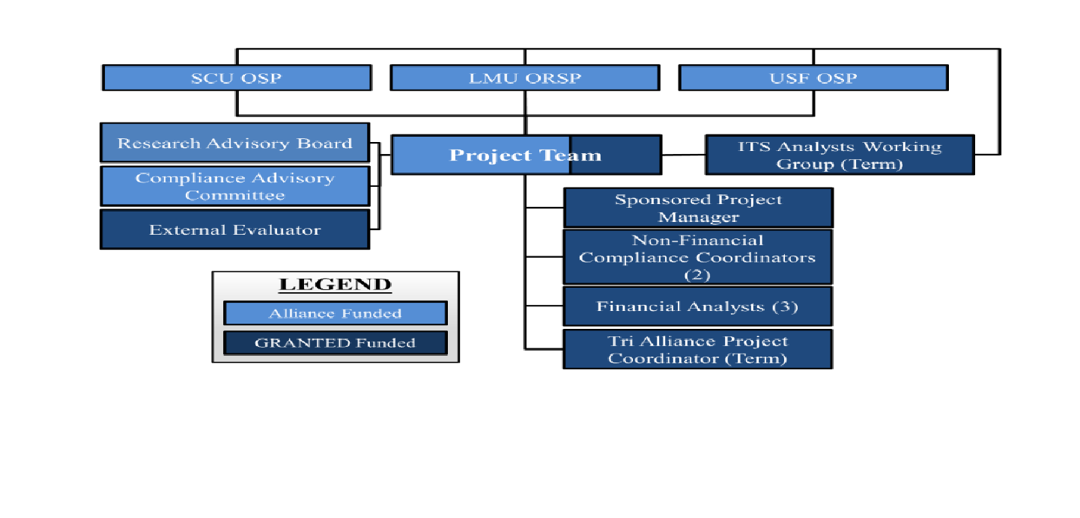
Organizational Structure to Build Capacity

Slide 12
LMU Structure & Benefits of the Tri-Alliance
Sponsored research infrastructure is in separate divisions:
Pre-Award in Academic Affairs
Post-Award in Finance
Corporate and Foundation Philanthropy (CFP) in University Advancement
Together, these offices work collaboratively to support identification of funding opportunities, proposal development, budget development, and fiscal management of awards.
Through the Tri-Alliance, we are piloting award advocacy support, joint training sessions of policies and processes for seamless faculty support, and ITS enhancements to ensure best practices in sponsored research activities throughout the university.

Slide 13
SCU Structure & Benefits of the Tri-Alliance
SPO is a full grant life cycle sponsored projects office
incorporates pre-award through post-award (including accounting)
administers grants that are initiated in Institutional Giving (CFR)
collaborates with Institutional Giving when gifts include research
Benefits of the Tri-Alliance
Through the Tri-Alliance, we are creating new positions; enhancing our services to researchers; identifying and filling gaps in our infrastructure, policies, practices, and documentation.
All these improvements will increase our ability to serve our faculty and others better and raise the profile of Santa Clara University as a research institution.

Slide 14
USF Structure & Benefits of Tri-Alliance
USF’s Office of Sponsored Programs handles the Post-award Functions for Corporate and Foundation Relations.
OSP and CFR have a joint Intent to Apply Form.
OSP and CFR meet bi-weekly to review the submissions and awards.
Capacity Building:
Enhances post-award infrastructure, reducing administrative barriers for funded faculty
Provides professional development for research staff and administrators
Collaborative Innovation:
Accelerates implementation of best-in-class practices through peer review
Pilots shared administrative roles to maximize expertise and efficiency
Network Expansion:
Opens pathways to regional and national funder networks
Creates opportunities for joint proposals and interdisciplinary projects

Slide 15
Replicable Strategies for Other Institutions
Toolkit Development: Documenting and packaging templates, policies, and workflows
Flexible Staffing Models: Role innovations adaptable to campus size and mission
Inter-Institutional Peer Review: Promotes continuous improvement
Cross-Functional Integration: Leverages existing infrastructure for maximum impact

Slide 16
Future Opportunities for Partnership
Scaling this model to other Jesuit and ERIs
Collaborating with funders to:
Expand training offerings
Deepen engagement with AJCU Institutions
Pilot industry-researcher partnership facilitation models

Slide 17
Inspiration for Partnerships
Adopt and adapt Tri-Alliance practices
Engage in cross-campus networks
Advocate for shared capacity-building grants
Expand professional network to learn and grow

Slide 18
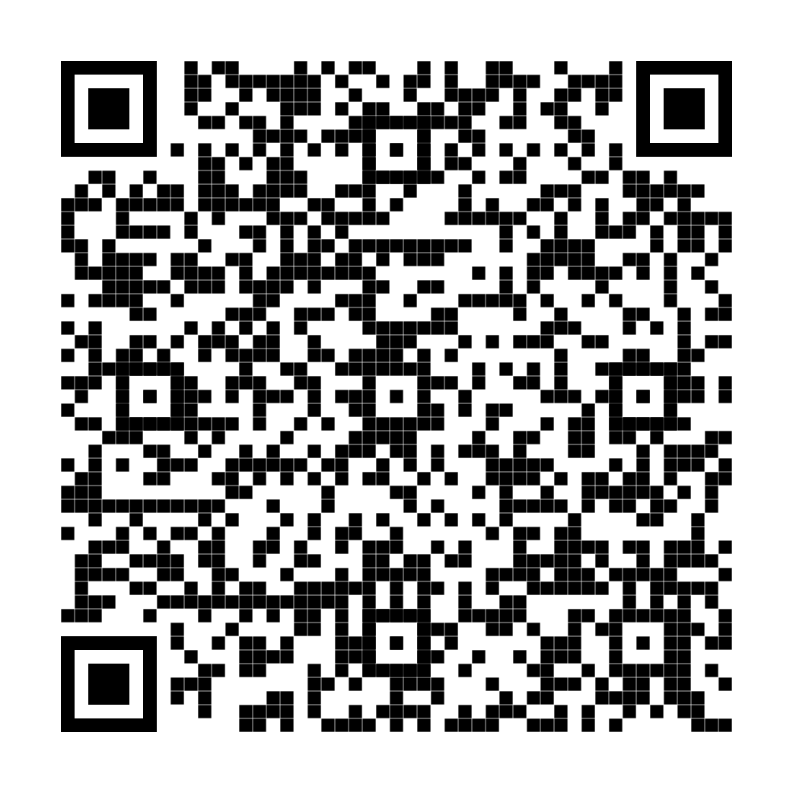
Contact Us
Rita Barreiro
Tri-Alliance Project Coordinator
Office for Research and Sponsored Projects Loyola Marymount University 1 LMU Drive Los Angeles, CA 90045-2659
Rita.Barreiro@lmu.edu
https://academics.lmu.edu/orsp/tri-allianceforpostawardinnovation/

