Slide 1

Sharing Our Stories - Alumni Engagement by Kimberly Batchelor Davis

Slide 2
Why Storytelling Matters Facts tell, but stories sell Humans are wired for narrative — it builds emotional connection and trust In a University setting, storytelling personalizes abstract goals (like access to scholarships, engagement, and alumni impact)
Notes:
We are wired to share and operate within our stories. Our stories are what connects us and each day we tell a story about ourselves.

Slide 3
Make the Mission Personal- Donor Engagement through Storytelling Share Student journeys and successes (Especially first-gen students) Use Alumni stories to reflect the legacy and continuity of the institution Highlight specific outcomes such as gifts, donations, scholarships, academic success
Notes:
Make your donor care about your cause or issue. Help the donor feel good about themselves and their support. Use qualitative methods along with statistics and data to tell a complete story.

Slide 4
Elevating Contribution through Narrative Share personal narratives of volunteers impacting student lives through mentorship or coaching Frame volunteer opportunities as acts of legacy building Celebrate behind the scenes of contributions (committee work, outreach, other forms of engagement)
Notes:
Storytelling plays a pivotal role in building community which acts a a bridge that unites people through shared experiences and emotions and including our shared Jesuit Mercy traditions and beliefs.

Slide 5
Engagement – Creating Community through Shared Stories Use consistent storytelling across platforms (emails, socials, and publications) Invite students, faculty, and alumni to share their own moments of achievements Story driven campaigns: reunions, fundraising campaigns, and student spotlights
Notes:
Engagement: Communication is the driving factor in engagement with 0-5 years 22.8% and declines in later years, 20 years or more11.9%-14.9% post graduation according to CASE studies 2024

Slide 6
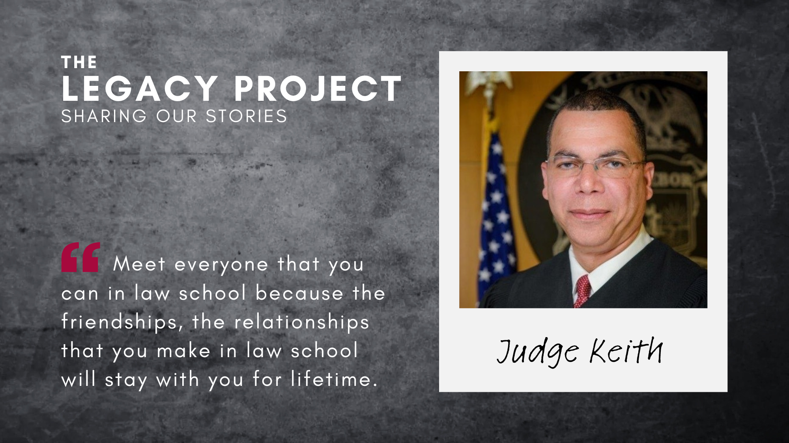

Slide 7
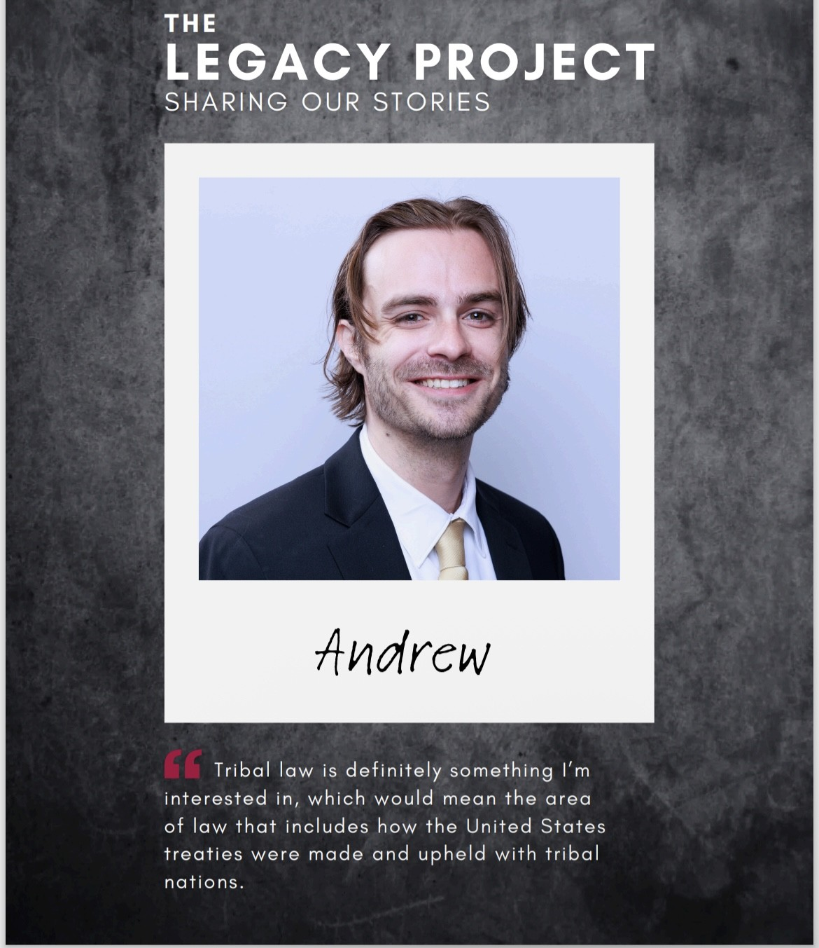

Slide 8
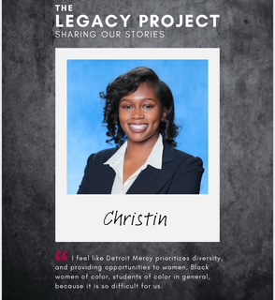

Slide 9
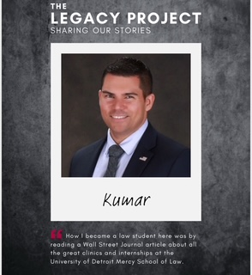

Slide 10
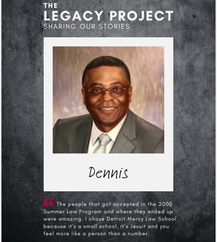

Slide 11
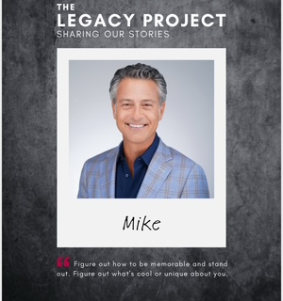

Slide 12
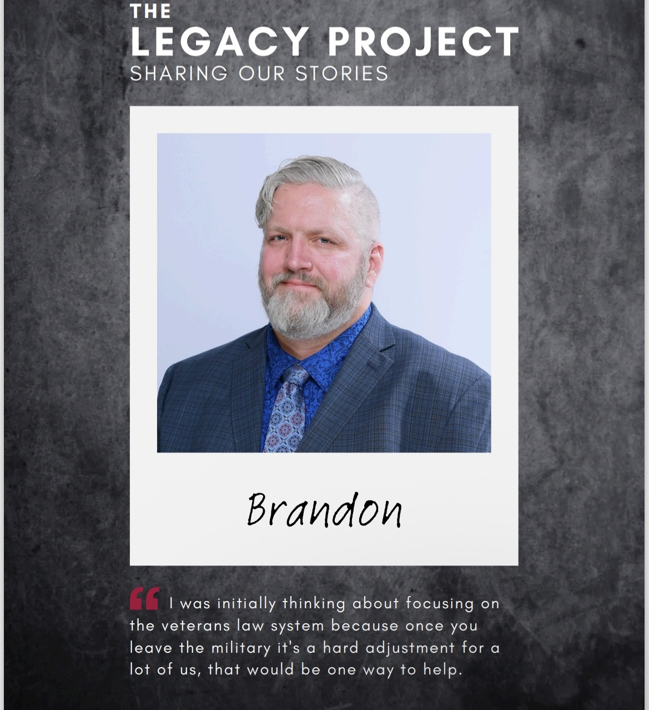

Slide 13
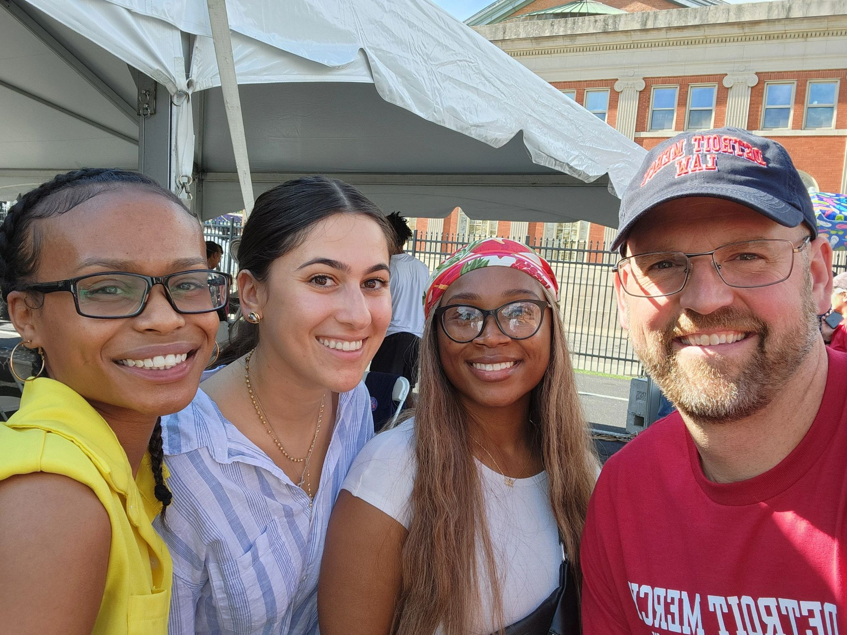

Slide 14
Practical Tips for Effective Storytelling Keep it authentic (use your voice) Focus on transformation (before/after narratives) Use visuals (photos, short video clips) Know your audience: tailor your stories to resonate with your specific groups

Slide 15
Channels to Share Your Stories Email Newsletters Alumni Magazines Social Media (LinkedIn) Events (Live storytelling or testimonials) Thank you communications (make them personal and story based)

Slide 16
Measuring Impact Click through rates Event Attendance Repeat Giving or First-time donors Volunteer sign ups and event registrations (I gave because I saw myself in that story)

Slide 17
Conclusion: Storytelling isn’t an add-on – it’s the strategy Every University or College has powerful stories waiting to be told When we tell the right stories, we don’t just raise funds – we raise the community

Slide 18
Kimberly Batchelor Davis Detroit Mercy School of Law Assistant Director of Alumni Relations batchekn@udmercy.edu www.linkedin.com/in/kimberly-batchelor-davis-3259a1

